Slide 1
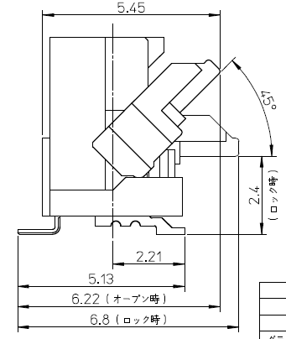
Open status：Before assembling the FPC
Close status: After assembling the FPC

Slide 2
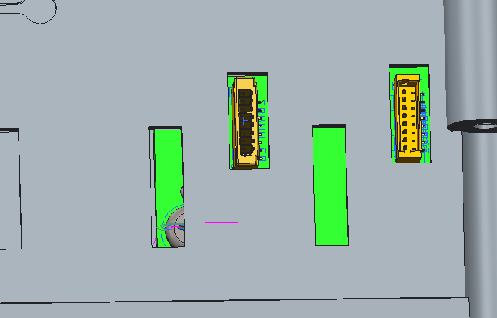
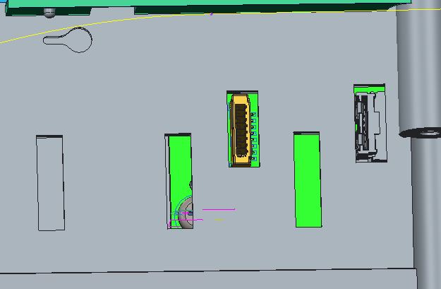
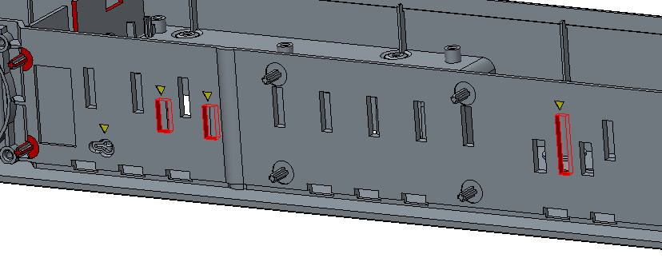
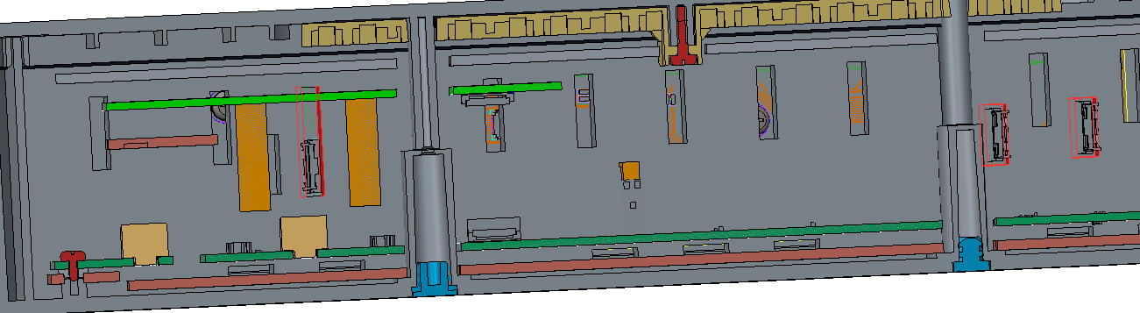
LED board and bottom cover
New FPC connector
Previous connector
Need to modify Bottom cover accordingly
Bottom cover

Slide 3
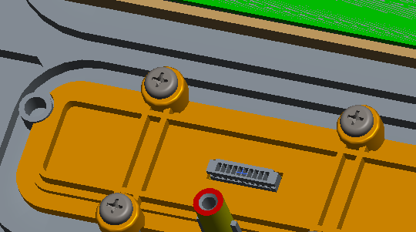
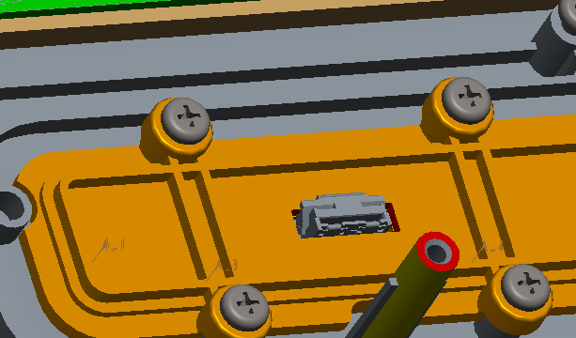
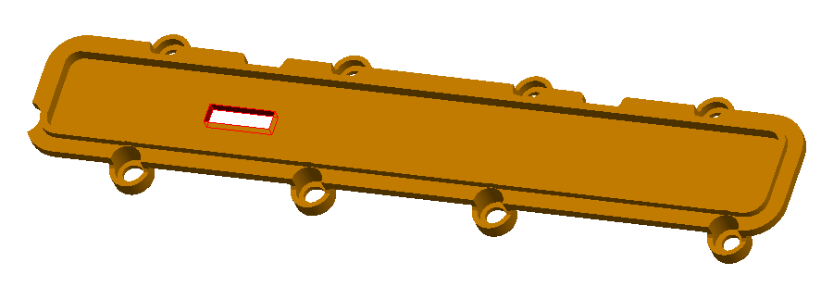
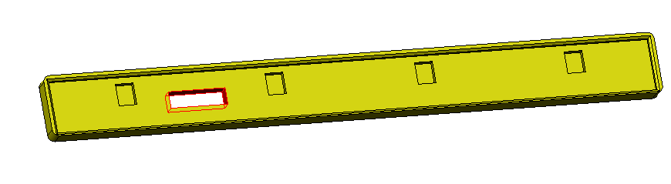
Mic board and mic-holder-part
New Mic FPC connector
Need to modify mic-holder-part and accordingly silicon-mic
Previous Mic connector
Mic silicon part
Mic holder part

